Slide 1
Monitoring
Infrastructure Monitoring
Notes:
Notes to the Facilitator:
Welcome the participants and give them an overview of the module. Tell them that they will learn about the ‘End User Monitoring’ in this module.
Notes to the Participants:
You will learn about the ‘End User Monitoring’ in this module.

Slide 2
Module Objective
At the end of this module, you will be able to:
Explain what is infrastructure monitoring
Identify the components of monitoring and the metrics
Differentiate the agent vs. agentless monitoring, reactive vs. proactive monitoring and cloud vs. on-premise monitoring
Explain network and security aspects of monitoring
List the challenges in infrastructure monitoring
List the available tools for infrastructure monitoring
Notes:
Notes to the Facilitator:
Explain the module objectives to the participants.
Notes to the Participants:
You will be informed about the module objectives.
At the end of this module, you will be able to:
Explain what is infrastructure monitoring
Identify the components of monitoring and the metrics
Differentiate the agent vs. agentless monitoring, reactive vs. proactive monitoring and cloud vs. on-premise monitoring
Explain network and security aspects of monitoring
List the challenges in infrastructure monitoring
List the available tools for infrastructure monitoring

Slide 3
Module Topics
This module covers the following topics:
Overview of infrastructure monitoring
Monitoring components and metrics
Agent vs agentless monitoring
Reactive monitoring vs proactive monitoring
Cloud vs on premise
Network and security monitoring
Infrastructure monitoring challenges
Tools overview
Notes:
Notes to the Facilitator:
Inform the participants about the topics that they will be learning in this module.
Notes to the Participants:
You will learn about the following topics in this module:
Overview of infrastructure monitoring
Monitoring components and metrics
Agent vs agentless monitoring
Reactive monitoring vs proactive monitoring
Cloud vs on premise
Network and security monitoring
Infrastructure monitoring challenges
Tools overview

Slide 4
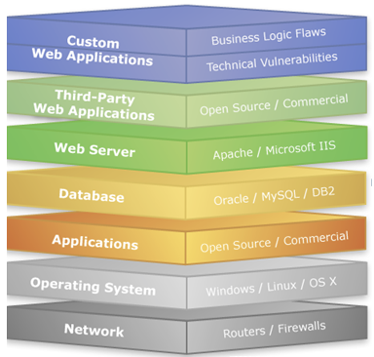
1.1 Overview
An Infrastructure monitoring tool:
A system, which is focussed on aggregating, shipping and storing the metrics of an Infrastructure.
Infrastructure comprises of the following components as shown in the image.
Source: https://www.greycampus.com/ckeditor_assets/pictures/241/content_web_server_attacks.bmp
Notes:
Notes to the Facilitator:
Explain the overview of infrastructure monitoring.
Notes to the Participants:
An Infrastructure monitoring tool is a system, which is focussed on aggregating, shipping and storing the metrics of an Infrastructure. The keyword here is infrastructure, in IT by we mean the platform over which all our applications are hosted, also the other middleware softwares like databases, cache system, cross domain network, and all of our network hardware managed. We can consider infrastructure as a home for applications, databases, other middlewares, and network. To keep all of the components to be healthy the home should be exempted with any flaws or issues. hence , it becomes necessary to have a monitoring system which can tell us about the health of the whole system.

Slide 5
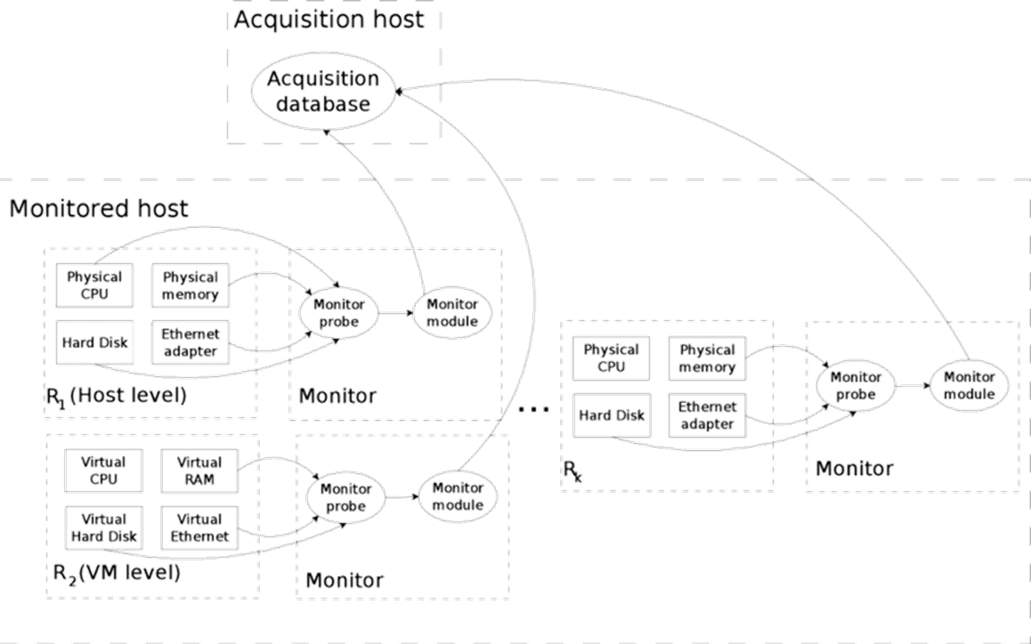
1.2 High-level View
The following diagram displays the high-level flow of monitoring and its components.
Source: https://www.researchgate.net/profile/Riccardo_Lancellotti/publication/228436316/figure/fig1/AS:669065089650692@1536528956425/High-level-design-of-the-monitoring-infrastructure.png
Notes:
Notes to the Facilitator:
Explain the high-level flow of infrastructure monitoring.
Notes to the Participants:
The beginning and end point of the flow of infrastructure monitoring is collecting metrics to visualising data collected, let's discuss about the stages that come in between.
Collector: It is a program or unit which runs inside a system, read system level metrics and expose them to a unix socket. A collector could be capable enough for even shipping the metrics to the aggregator or directly to the databases which are next stages to the collector.
Aggregator: An aggregator acts as a filter to clear out noises and forwards the necessary information to the database. Here, the noise means the information which is not required by the administrators for monitoring, because the collector picks up all information available in the system and sends all them out which sometimes overwhelming to the administrators. Also, if we keep information without filtering it will to unnecessary in out databases and it leads to costs to manage them.
Databases: When we talk about monitoring we consider every event to be real-time, because a delayed information is of no use. The databases we use for monitoring is usually a time-series based.

Slide 6
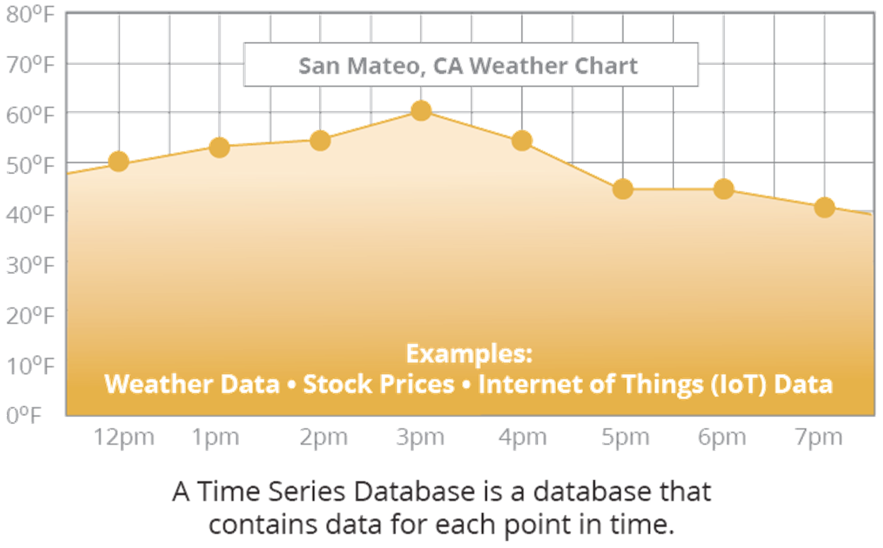
1.3 Time Series Database (TSDB)
Time series databases are highly used for monitoring purposes.
The following chart displays an example of time-series database.
Notes:
Notes to the Facilitator:
Explain the Time-series databases for Infrastructure Monitoring to the participants.
Notes to the Participants:
A time series database (TSDB) is a database, which is optimized for time series data. The domains where events are logged with respect to time TSDB are highly used over there. The event, which we are discussing here, could be application performance monitoring, server metrics, sensor data, network data, events, clicks, trades in a market and different types of analytics data.

Slide 7
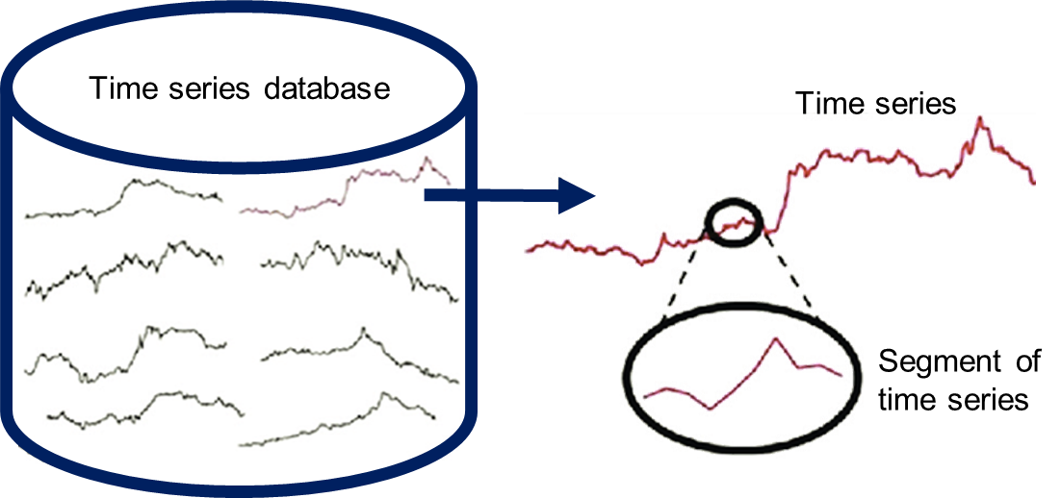
1.3.1 Why TSDB
To get the real time information about system, we need a databases, which works well with timestamp.
Notes:
Notes to the Facilitator:
Explain why Time-series databases for infrastructure monitoring is required.
Notes to the Participants:
For monitoring purpose, time series databases are required. They were earlier used in finance industry, stock market and other domains, where real time information was critical. But for the last decade, the fundamentals of conditions of computing have changed a lot and with the growth of digitalisation, everything is being processed on faster pace. To keep up with the application usage by consumers, the monitoring setup also needed an upgrade to keep up with the speed.

Slide 8
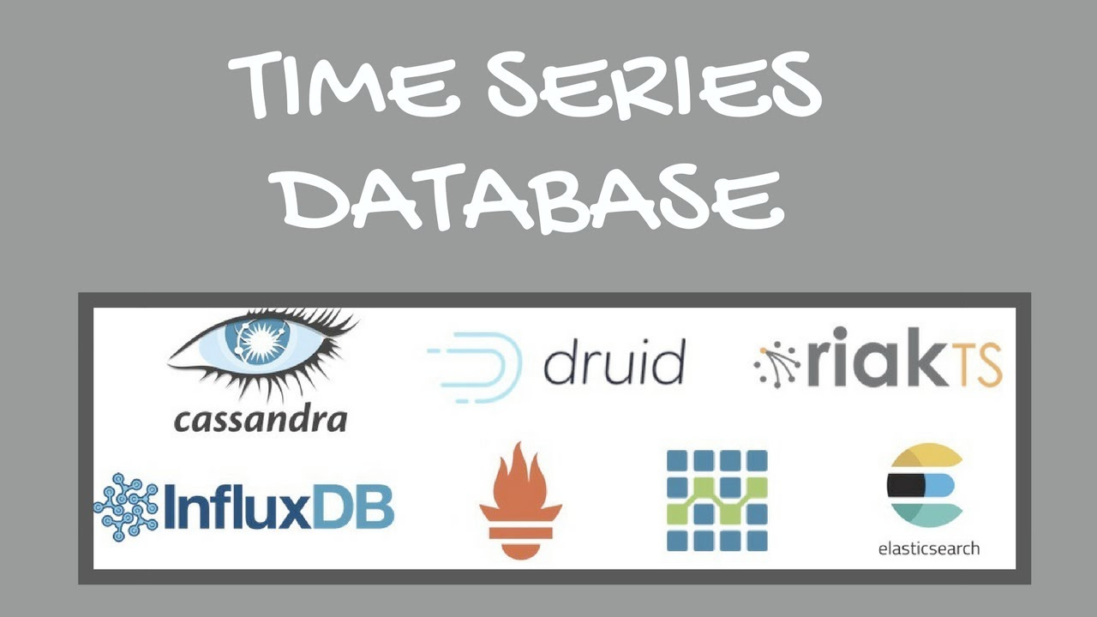
1.3.2 Few TSDB Available in Market
Notes:
Notes to the Facilitator:
Explain few TSDB for monitoring, which are available in market.
Notes to the Participants:
Here are some popular TSDB:
Cassandra
Druid
RiakTS
InfluxDB
Prometheus
OpenTSDB
ElasticSearch

Slide 9




1.3.3 What Needs to be Monitored
There are several components, which needs to be monitored. These are:
Hardware
Operating Systems
Virtualization Network
Applications
Notes:
Notes to the Facilitator:
Explain the topic what needs to be monitored in Infrastructure Monitoring.
Notes to the Participants:
There are several components, which needs to be monitored. These are:
Hardware – IBM Director, Insight Manager, and OpenManage
Operating Systems – Windows, Unix, and Linux
Virtualization – VMware and Hyper-V
Network – SNMP enabled devices
Applications – Database, Messaging, and Web

Slide 10
What did You Grasp?
Monitoring of hardware systems is known as …….
End user monitoring
Infrastructure Monitoring
Application monitoring
Log Monitoring
Notes:
Notes to the Facilitator:
Answer:
B. Infrastructure monitoring

Slide 11
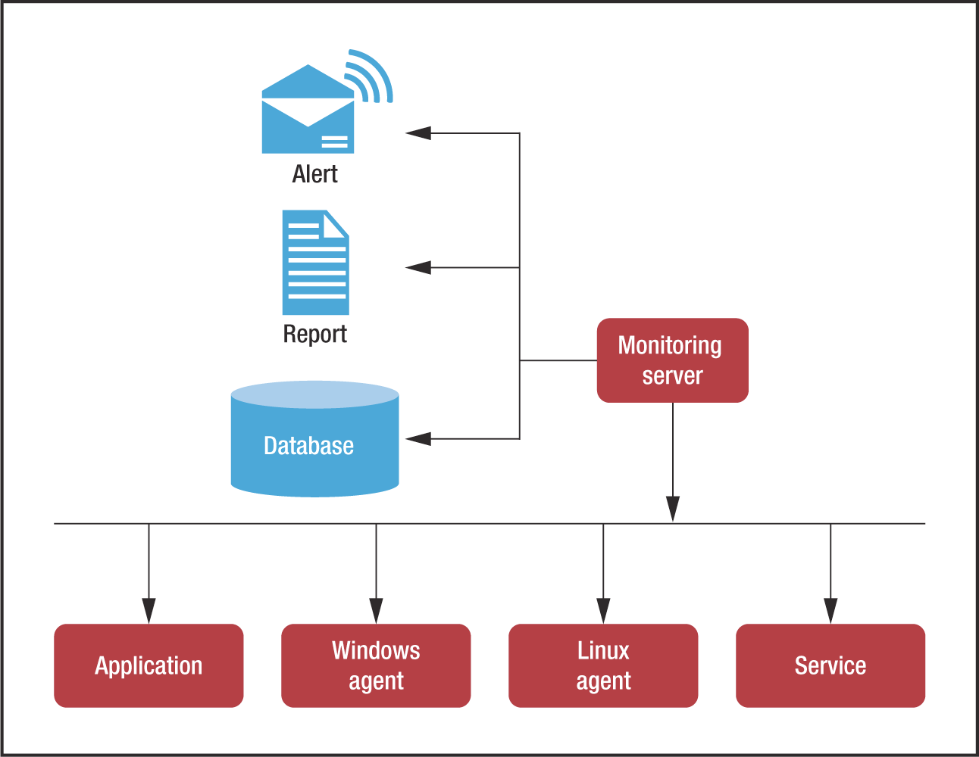
1.4 Monitoring Components and Metrics
The components of monitoring are stages via which the information traverse.
Source: https://csdl-images.computer.org/mags/so/2015/04/figures/mso20150400881.gif
Notes:
Notes to the Facilitator:
Explain the monitoring components and metrics.
Notes to the Participants:
There are certain components of monitoring that are involved to keep a check on infrastructures health.
Program details
Data Collection Plan
Monitoring Plan
Evaluation Plan
How the plan will be used

Slide 12

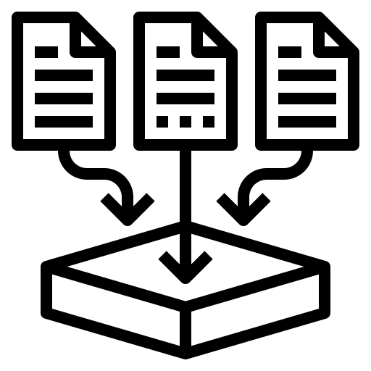
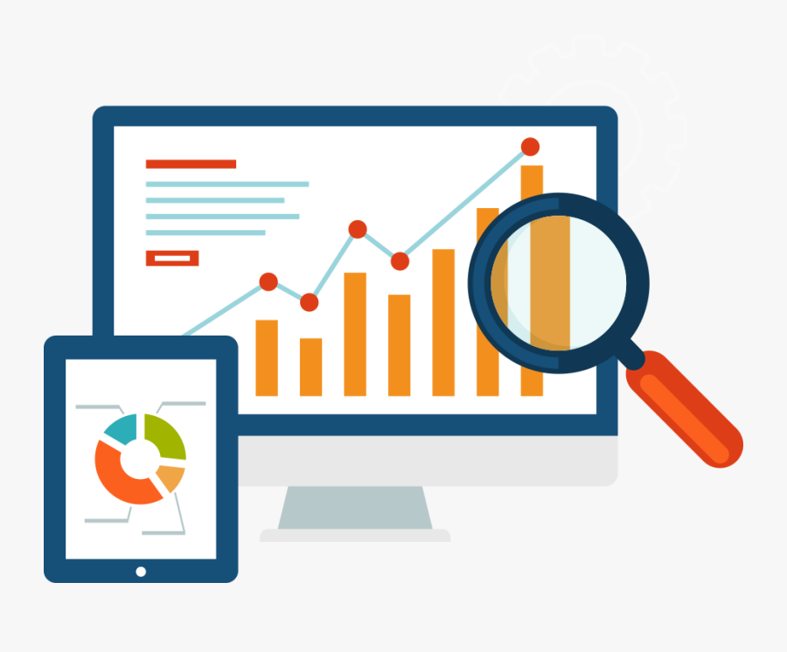


1.4.1 Monitoring Components
Various monitoring components are:
Program details
Data collection plan
Monitoring plan
Evaluation plan
How the plan will be used
Notes:
Notes to the Facilitator:
Explain the various monitoring components.
Notes to the Participants:
Let us discuss the monitoring components in detail.
Program details: This is the fundamental detail regarding a program which has various components like why it is needed, what are the objectives, the number of resource required, and details of the activities going to be involved. Basically it is the end to end documentation of the plan consist of enabling the monitoring.
Data collection plan: As we know the first stage of any kind of monitoring is to collect data for the source, and this needs to be planned well because the agent which is going to collect data from source needs to be fine tuned as the number of sources are huge in number. Majorly it consists of method of data collection, analysis and reporting. Extra care should be taken care with the possible challenges to be faced.
Monitoring plan: This is a detailed plan involving the mentioning of the specific data to be collected in accordance with frequency it is collected. The frequency must be enough to suffice the use case of project vulnerabilities. Further after getting the data with a certain frequency the threshold and indicators should be used to measure results.
Evaluation plan: It is a part where the overall genuinity and profitability of a program is evaluated. The business owner or the management checks up on the pros and cons of the plan and gives a go ahead if seems suitable to the current scenario, or seems promising for future benefits.
How the plan will be used: It is more of a pre-execution phase of a program, where teams decide upon what product to be used and how it should be used to reap maximum benefits. It also includes all the stakeholders who will access the plan and use the collected data. It also includes where and how the data and findings will be stored, such as a report or dashboard.

Slide 13
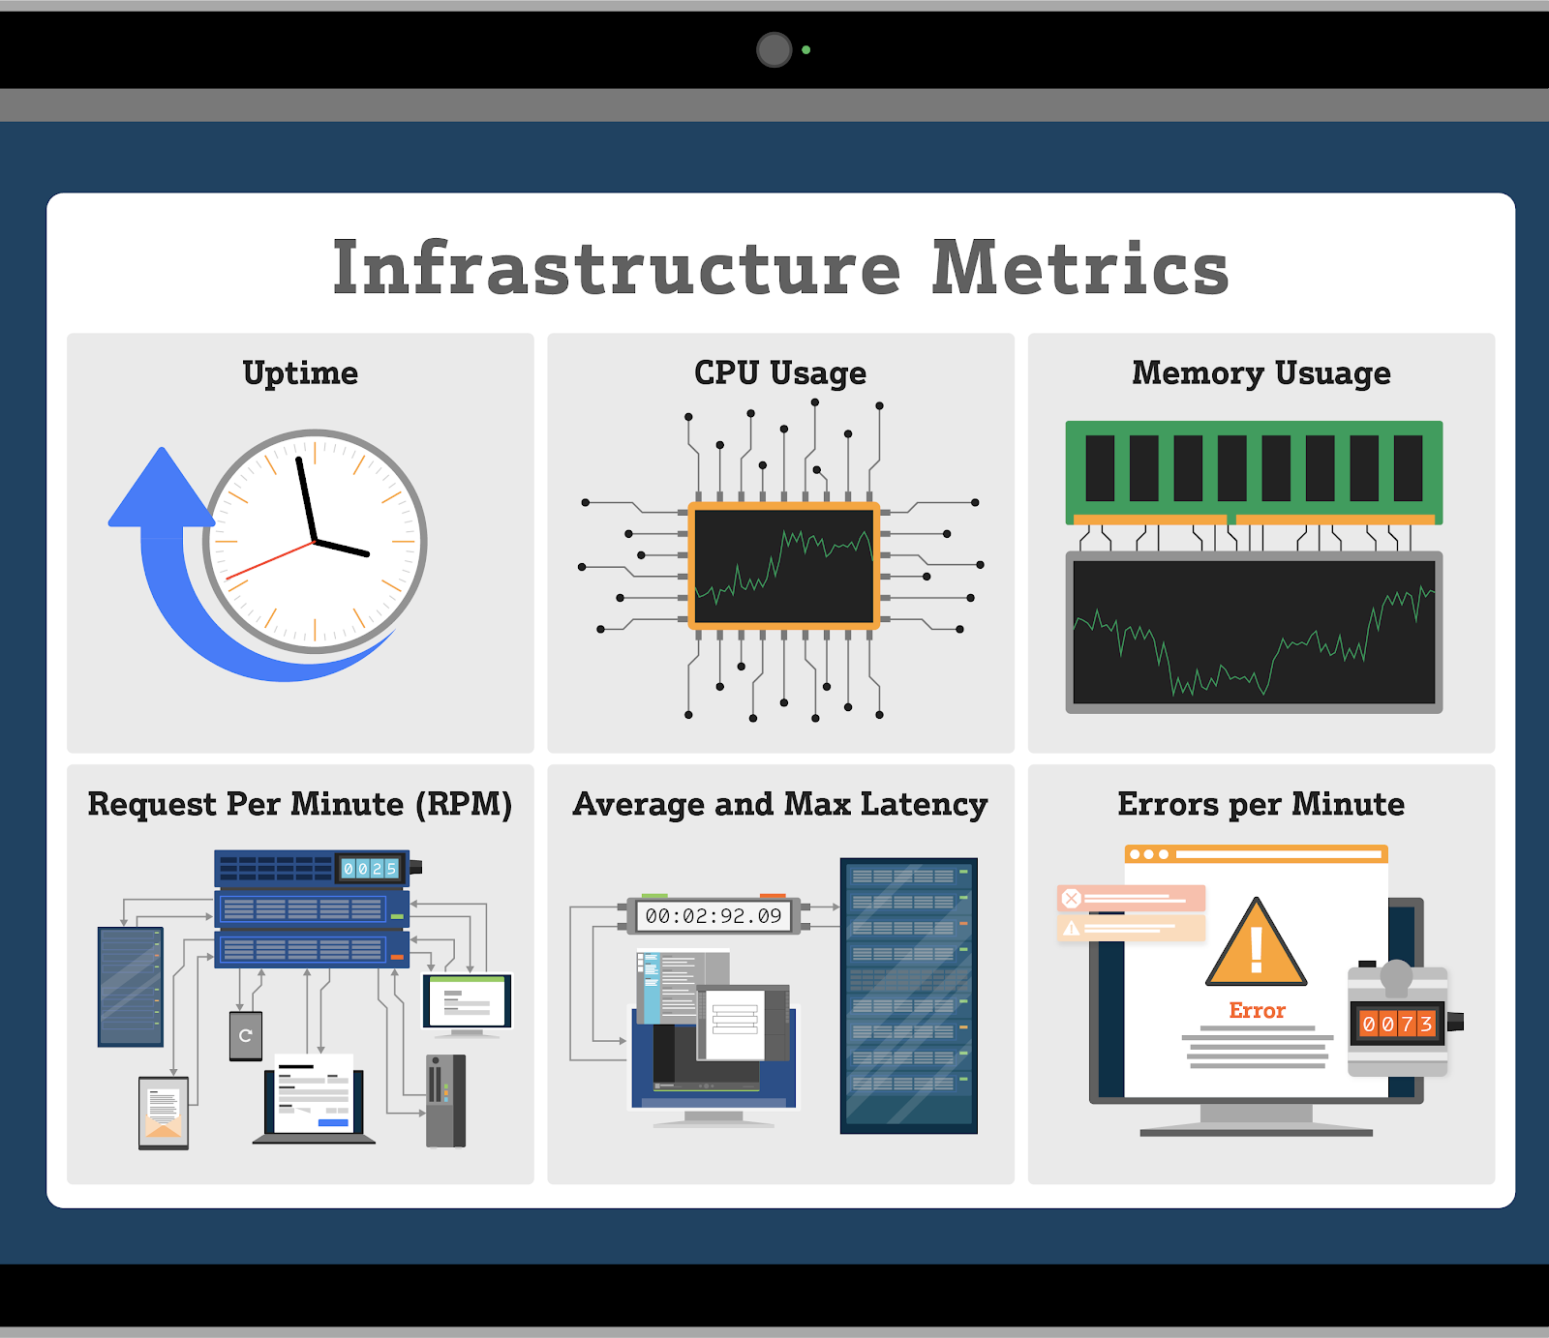
1.4.2 Metrics
The data points, which are collected from the source for monitoring.
Source: https://www.apiscene.io/wp-content/uploads/2020/06/infrastructure-metrics-apiscene.png
Notes:
Notes to the Facilitator:
Explain to the participants are Metrics.
Notes to the Participants:
The raw measurements of resource usage or information that can be collected and used throughout the system is called metrics. This could be a low-level summaries or high-level summaries sourced from operating system. One of the easily accessible metrics exposed by the operating system to show the underlying physical resource. The basic information about CPU, disk space, swap usage, load, etc. are the metrics, which provide value immediately, and then can be furthered to a monitoring system.

Slide 14
What did You Grasp?
What is the name of data point which is collected by monitoring system?
Time series database
Metrics
Aggregator/filter
Alerting system
Notes:
Notes to the Facilitator:
Answer:
A. End User monitoring

Slide 15






1.5 Agent vs Agentless Monitoring
There are two ways of collecting data for monitoring:
Agent based
Agent less
Notes:
Notes to the Facilitator:
Explain what is agent vs agentless monitoring.
Notes to the Participants:
There is an ongoing debate around which one is better to have in our infrastructure Agent based or Agentless monitoring. There are several pros and cons to both of the methodologies. Let us debunk, which one will suit better in accordance with the use case of projects.
Agent based: Where no agent os deployed in the system
Agent less: Where a agent is deployed in the system

Slide 16
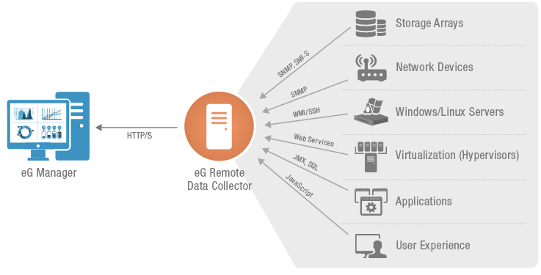
1.5.1 Agentless Monitoring
The approach, where data is collected from outside system. The following image represents the agentless monitoring.
Source: https://www.eginnovations.com/images/eg-enterprise-agentless-monitoring.jpg
Notes:
Notes to the Facilitator:
Explain what is agentless monitoring.
Notes to the Participants:
This method is one of the most popular of the the two methods. In this type of monitoring we usually count on SNMP, WMI, SSH or any other protocol to broadcast information to the central monitoring software with metrics about the system.
However, it might seem simple and easy, hardware and software manufacturers have integrated these built-in features to broadcast information in the production system. In this age and time with the increase in popularity of agentless monitoring these management agents are integrated within the software/hardware and provides central management and monitoring without any external agents installed.
Hence, we can say they're agentless, but the software agent is already built into the platform natively.

Slide 17
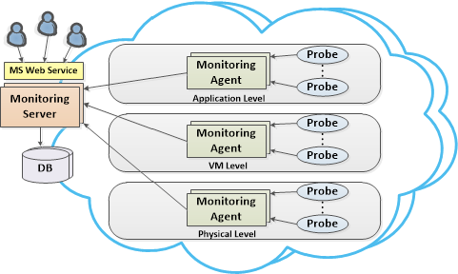
1.5.2 Agent based Monitoring
The approach, where data is collected from inside system. The following image represents the agent based monitoring.
Source: https://www.researchgate.net/profile/Marios_Dikaiakos/publication/271428939/figure/fig1/AS:295242642280453@1447402739442/Abstract-Architecture-View-monitoring-metrics-from-the-Cloud-element-they-reside-on-and.png
Notes:
Notes to the Facilitator:
Explain what is agent-based monitoring.
Notes to the Participants:
In this approach a monitoring get its hand dirty to read data in a raw from from the system while being part of it. It allows us to aggregate, and analyze more data from a given system. We now have agents that are especially programmed for the respective platform to interact with it specifically.
This can be considered as a positive or a negative approach , depending on point of view and use cases..
The advantage of having agents that are vendor specific is that they give you information which agentless monitoring system cannot accomplish. The disadvantage of this is that agents are locked into that platform and migrating systems to a new platform will cause losing that in-depth data.

Slide 18
What did You Grasp?
Which monitoring uses embedded programs in platform to fetch metrics of a system?
Proactive monitoring
Agentless Monitoring
Agent based monitoring
Reactive Monitoring
Notes:
Notes to the Facilitator:
Answer:
B. Agentless monitoring

Slide 19

1.6 Reactive vs Proactive Monitoring
This segregation is based on how we respond to an event triggered by monitoring
Proactive
Reactive
Notes:
Notes to the Facilitator:
Explain the Reactive vs Proactive monitoring to the participants.
Notes to the Participants:
Proactive approach: Whenever the monitoring system sees a possibility of occurrence of an issue it heals itself. In other words, proactive approach focuses on removing the problems before they occur.
Reactive approach: This type of approach takes place after the event has been triggered. In this approach, the administrator needs to respond to the events after their occurence. The main difference among the two approaches is that the perspective each approach provides in analysing actions and events.

Slide 20
What did You Grasp?
In which monitoring The problems are eliminated before they occur?
Proactive monitoring
Agentless Monitoring
Agent based monitoring
Reactive Monitoring
Notes:
Notes to the Facilitator:
Answer:
A. Proactive monitoring

Slide 21
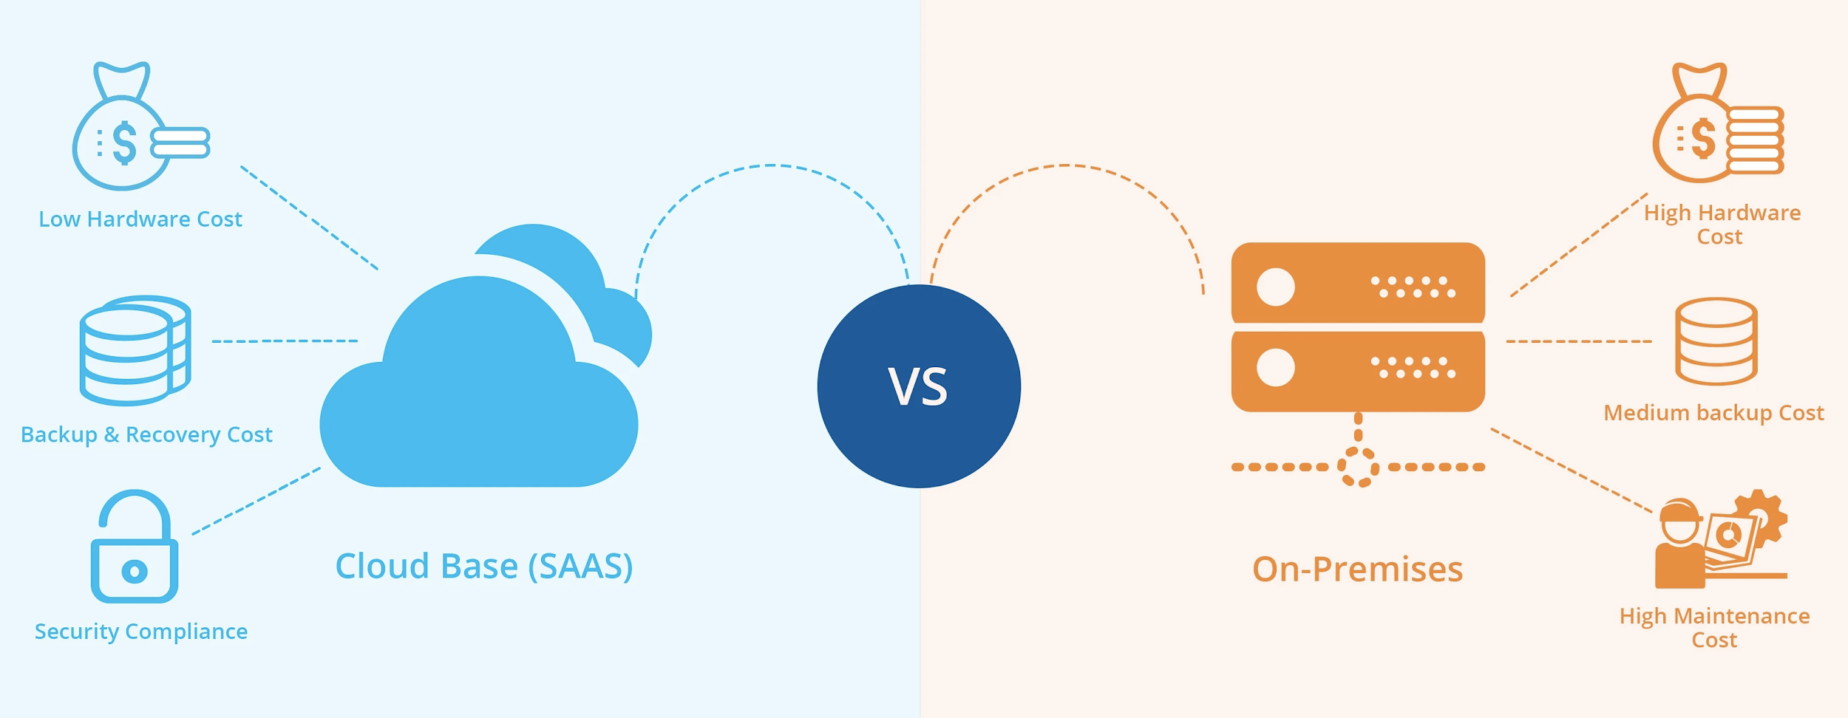
1.7 Cloud vs On-Premise
The following image illustrates the difference between cloud vs on-premise monitoring.
Source: https://cdn2.hubspot.net/hubfs/2295024/blog-images/Cloud%20Vs%20On%20Premises.jpg
Notes:
Notes to the Facilitator:
Explain the difference between cloud vs on-premise Infrastructure.
Notes to the Participants:
Before we undergo the discussion of how monitoring works in both scenarios. Let’s discuss the difference between cloud and on-prem Infrastructure.
On-premise Infrastructure: It the legacy model where we get to set up our own data centre with hardware layer, network layer, OS layer, storage capacity and then application layer. We need to manage all of the components all by own 24X7. This usually leads to high hardware cost, medium backup cost, and high maintenance cost.
Cloud Infrastructure: It is the new age model where people devoid from all maintenance responsibilities and want to pay for use. In this scenario teams get infrastructure as a service whatever you use be it servers, network, storage and other hardware you pay for it. This results in low hardware cost, low backup and recovery cost. Also, you don’t need to worry about security compliance. In this model teams get more time to invest on development rather than maintaining the infrastructure.

Slide 22
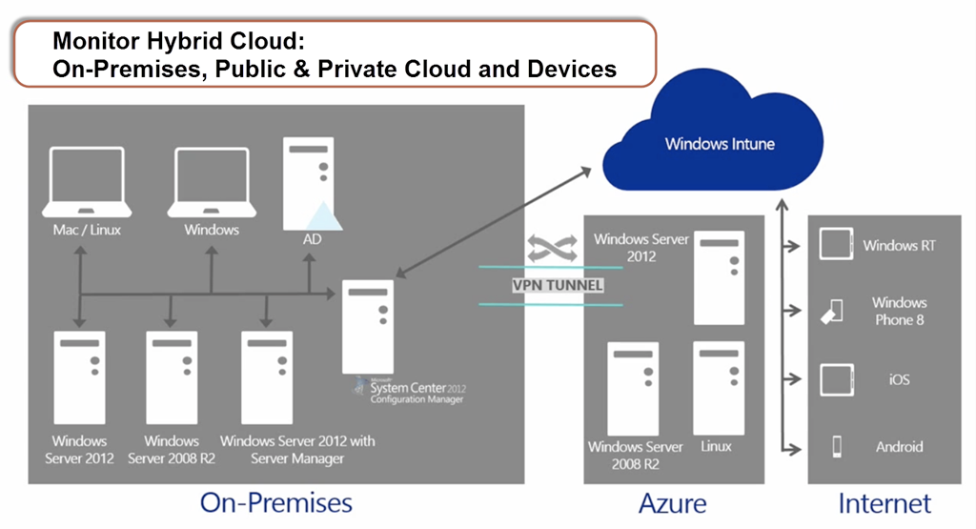
1.7.1 Monitoring in Cloud vs On-Premise
In this part we’ll discuss how monitoring is done in cloud and on-prem infrastructure.
Source: https://itproguru.com/wp-content/uploads/2014/09/image.png
Notes:
Notes to the Facilitator:
Explain the Monitoring in Cloud vs On-premise Infrastructure.
Notes to the Participants:
Cloud based Monitoring: Setting up Monitoring is a technical process and customers who want to devoid from that can opt for cloud based monitoring, as we call them a SaaS-based monitoring platform. In a cloud-based monitoring setting, the setup and integration of your applications is very easy. The access is ordered, the monitoring tasks are configured, and the monitoring data is immediately gets starts collecting. From beginning to end all operational activities such as backups, security updates or installation of new features on this monitoring setup is done by the service provider. We only need to focus all our efforts on configuring monitoring tasks, activating alerts, and analyzing results. In this case, we get plenty of time because instead of dealing with time consuming deployments we can focus more on development.
On-premise Monitoring: Way before the cloud technologies bombarded the IT industry, most of the monitoring solutions were hosted on an organization’s internal network. Teams agreed on a license contract, payed the initial license fees, and the vendor shipped the setup procedures for their monitoring setup.And then the operation tasks started out like planned rollout, ordering the required hardware, installing the monitoring components, and deploying the monitoring agents across their data center. The internal teams were fully in charge of dealing with all technical monitoring challenges. Most of the times it lead to a hustle to investe the issues because a local deployment which brings too much uncertainty, delaying issue analysis often for days. In recent years on-premises monitoring suites have become slightly outdated.

Slide 23
What did You Grasp?
Which monitoring suite offers a SAAS based solution?
Cloud Monitoring
On-Prem Monitoring
Hybrid Monitoring
Pay as per usage model
Notes:
Notes to the Facilitator:
Answer:
A. Cloud monitoring

Slide 24
1.8 Network and Security Monitoring
In this segment, we’ll discuss how to keep check of network health and security.
Network Security Monitoring
Network
Monitoring
Goal: Prevent downtime
Security
Monitoring
Goal: Protect data
Goal:
Keep the
business
running
Notes:
Notes to the Facilitator:
Explain the network and security monitoring to the participants.
Notes to the Participants:
Network Monitoring A system, which monitors and tracks the network activity regarding issues or problems caused by malfunctioning devices or overloaded resources like servers, network connections or other devices is called network monitoring system. The usual network monitoring is frequently performed by using ,dedicated applications, diagnostic tools or appliances attached to the network. The data points we get is used to measure the following metrics:
Availability
Performance
Configuration of system
Security Monitoring
Security monitoring protects the infrastructure from the numerous potential vulnerabilities and exploits in the wild. Most importantly than general monitoring, security monitoring is use to analyze complex factors like network protocols, network payload, encrypted traffic sessions, client-server communications, traffic patterns, and traffic flow in order to alert administrators for known malicious activities.

Slide 25
What did You Grasp?
Which monitoring looks after the encrypted session ?
Network monitoring
Security Monitoring
Application monitoring
Log Monitoring
Notes:
Notes to the Facilitator:
Answer:
B. Security monitoring

Slide 26
1.9 Infrastructure Monitoring Challenges
The following are the challenges in infrastructure monitoring:
Create modern monitoring for modern environments
Develop customised dashboards and visualisations
Instil a culture of visibility
Achieve greater efficiency and scale
Notes:
Notes to the Facilitator:
Explain the infrastructure monitoring challenges to the participants.
Notes to the Participants:
The following are the challenges in infrastructure monitoring:
Create modern monitoring for modern environments:
To be ahead in the game one needs to strive for upgrade and update similarly with our traditional monitoring tools which run on-premise, which means that extra resources are needed for proper management. This can be avoided by moving to cloud-based infrastructure, teams which can maintain a competitive advantage by scaling infrastructure quickly and shortening of the software release cycles.
Develop customised dashboards and visualisations:
Most of the modern monitoring solutions may give some straight out-of-the-box solutions and insights, but to enhance their capability and unleash their real power they need to be tuned and customised. Identifying and troubleshooting problems can be simplified when the telemetry data is customised to the specific use cases that are critical to businesses.
Instil a culture of visibility:
With the increase in development in the of modern microservices architecture, deployments become simplified, and end-to-end visibility across the whole infrastructure can be made possible.
In accordance to this new age architecture modern monitoring solutions typically require teams to jump between using different tools that operate across other parts of the infrastructure. This wastes time and can lead to human error.
Achieve greater efficiency and scale:
With an increase in demand and consumption of online services having the ability to scale monitoring tools with the same pace as scaling infrastructure is crucial. The Proactive monitoring is needed to detecting and eradicate anomalies and automating connections between incidents and events is crucial to reducing noise, and helps to identify the most pressing issues. Detailed information allows incidents to be troubleshoot at much faster pace , and the root cause can be found early.

Slide 27
What did You Grasp?
Which stage is the end point of the Infrastructure monitoring?
Collecting metrics
Processing/aggregating data
Storing data
Visualising data
Notes:
Notes to the Facilitator:
Answer:
D. Visualising data

Slide 28
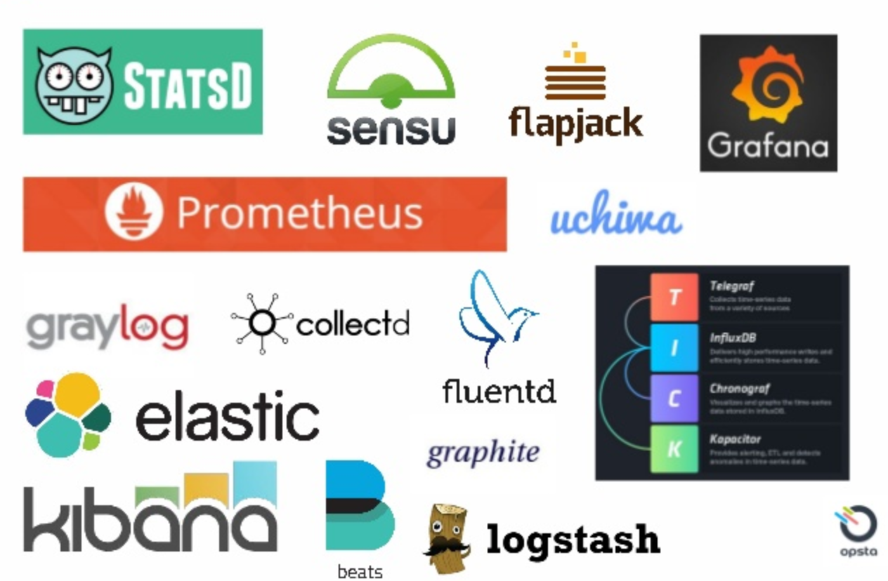
1.10 Tools Overview
Some of the prominent Infrastructure monitoring tools are:
Notes:
Notes to the Facilitator:
Explain the infrastructure monitoring tools to the participants.
Notes to the Participants:
Some of the prominent Infrastructure monitoring tools are:
StatsD
Sensu
FlapJack
Grafana
Prometheus Stack: Exporters, Prometheus and Grafana
InfluxDB Stack: Telegraph, InfluxDB, Chronograph and Kapacitor
Uchima
Graylog
CollectD
Elastic Stack: Beats, logstash, Elasticsearch and Kibana

Slide 29
What did You Grasp?
What should be the nature of agent in Infrastructure monitoring?
Have minimum resource footprint
Collects all resource data
Should have plug-in play model
All of the above
Notes:
Notes to the Facilitator:
Answer:
D. All of the above

Slide 30
In a Nutshell
In this module, you learnt:
Overview of infrastructure monitoring
Components of monitoring and the metrics
Monitoring on the basis of agents
Activeness as the basis of monitoring
Infrastructure on cloud and on-prem
Network and security aspects of monitoring
Challenges faced in infrastructure monitoring
Brief overview of tools available to do infrastructure monitoring
Notes:
Notes to the Facilitator:
Share the module summary with the audience.
Ask the participants if they have any questions. They can ask their queries by raising their hands.
Notes to the Participants:
Now, you have reached the end of the module, In this module, you learnt:
Overview of infrastructure monitoring
Components of monitoring and the metrics
Monitoring on the basis of agents
Activeness as the basis of monitoring
Infrastructure on cloud and on-prem
Network and security aspects of monitoring
Challenges faced in infrastructure monitoring
Brief overview of tools available to do infrastructure monitoring

Slide 31
Next Module 4: Application Monitoring

